Slide 1

MindEase
Krishang Patel

Slide 2
MVP Technical Requirements Breakdown
Overview:
Landing Page
Time and an inspiring quote that changes every visit.
Guided Meditation
A library of meditations that the user can pick from and play.
Well made and responsive.
Personalized Meditation
User is prompted by a few question regarding how they are feeling in the current moment.
Upon evaluation of their response, a personalized mediation track is played. (AI powered)

Slide 3
MVP Technical Requirements Breakdown
Technical Specifications:
React Framework (Next.js)
JavaScript
HTML
No DB required.

Slide 4
MVP Technical Requirements Breakdown
Challenges & Solutions:
How to evaluate which meditation is best for the user?
Every survey question holds weight to it. (3 good, 2 neutral, 1 bad)
Every video also holds the weight to it. For example, a relaxation video for sleep hold the wight of 3 for the question “How was your sleep?”.
How to make it responsive on Web as well as Mobile?
Tailwind CSS

Slide 5
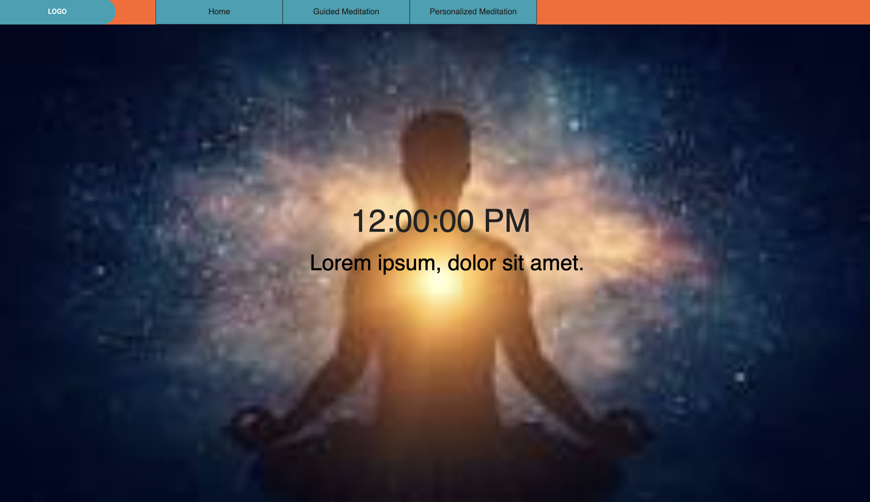
Design & UI Approach - Tailwind
Landing Page

Slide 6
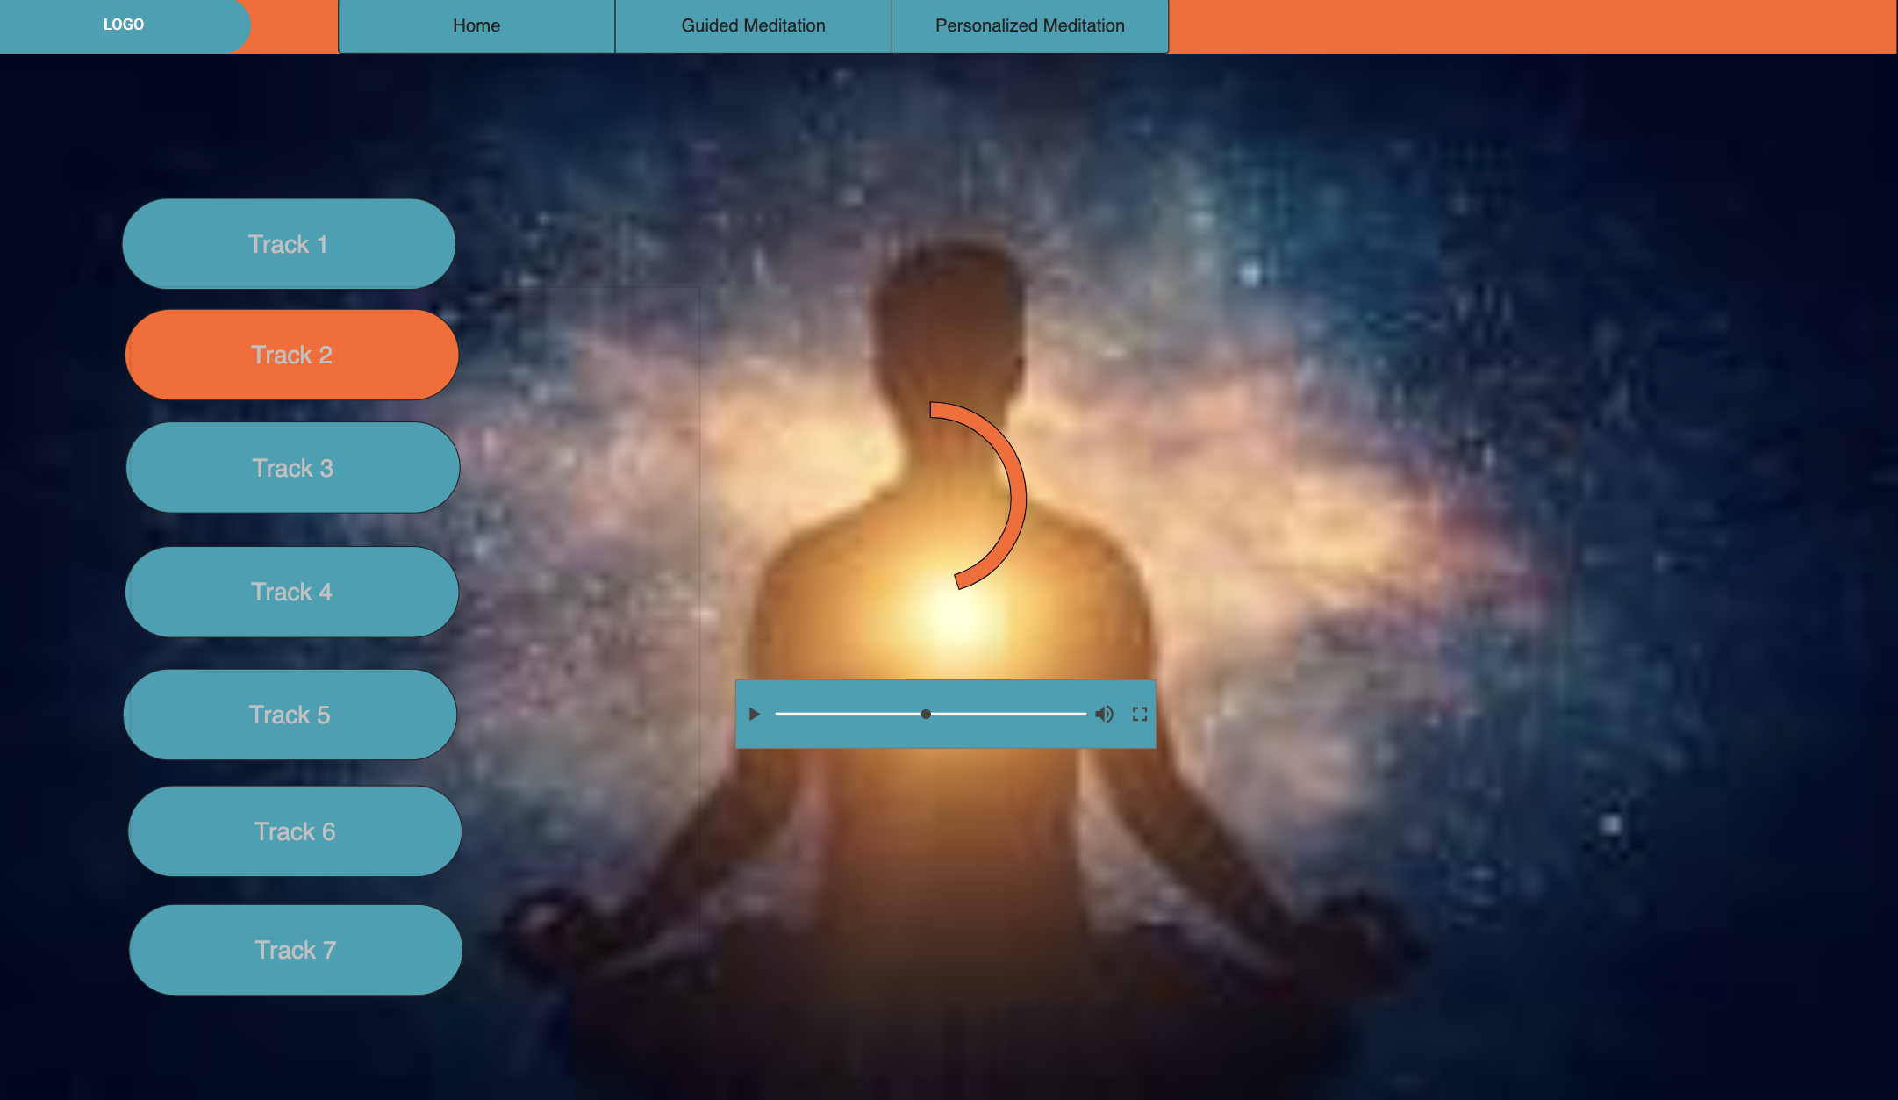
Design & UI Approach - Tailwind
Guided Meditation

Slide 7
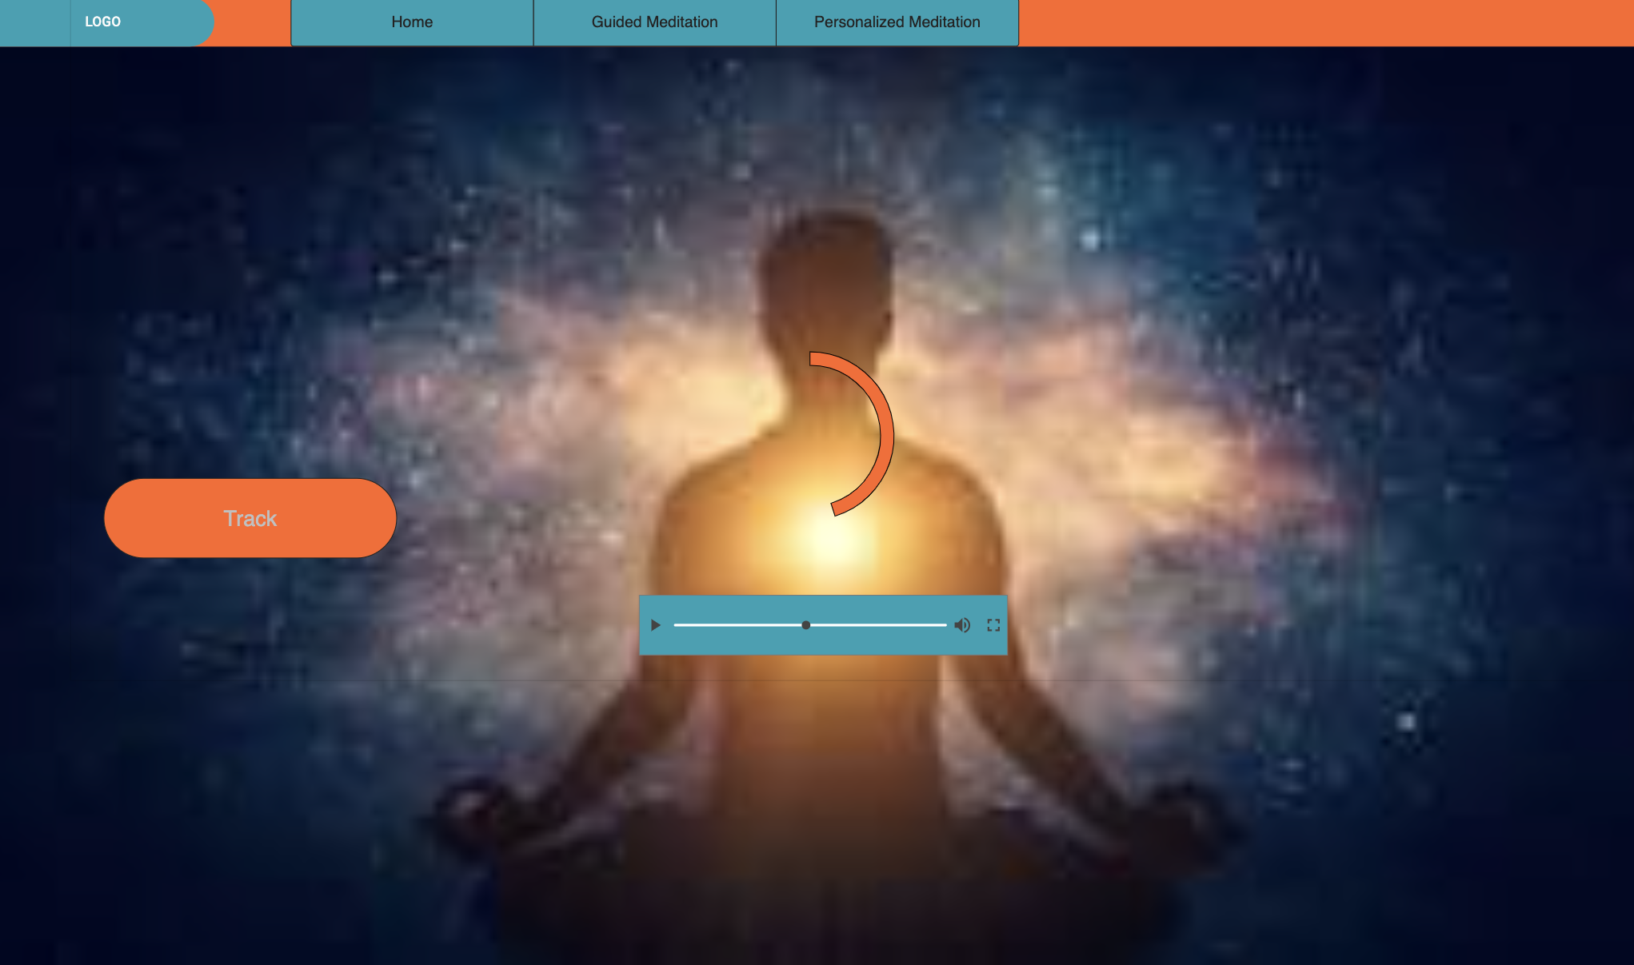
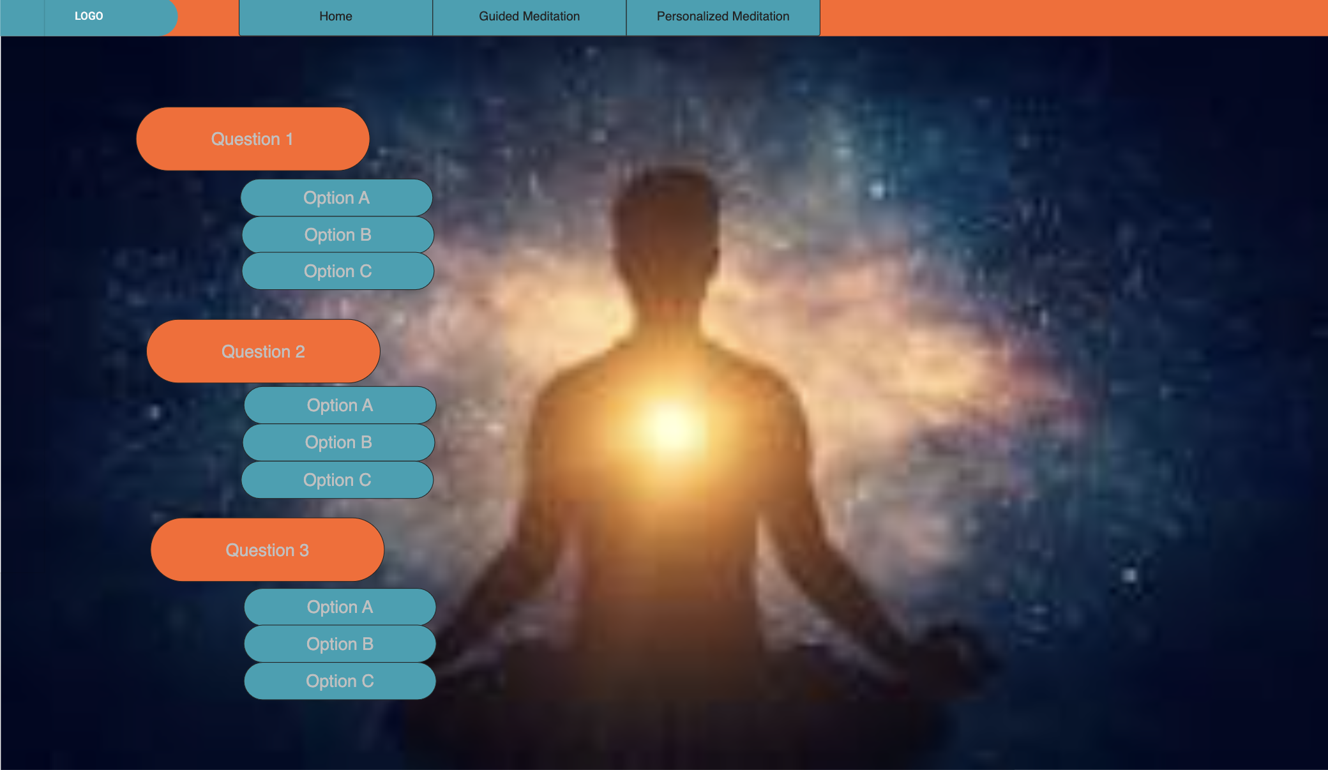
Design & UI Approach - Tailwind
Personalized Meditation

Slide 8
Sprint Planning & Progress
Sprint 1 (Completed)
Initialize the project and get it to work with all the required tools.
Create the homepage and a functional guided meditation page.
Sprint 2 (To-do)
Video tracks need to be changed to Audio
Add a visible time tracker that shows the progress of the track being played.
Create the personalized meditation page.

Slide 9
Code Repository

